Slide 1
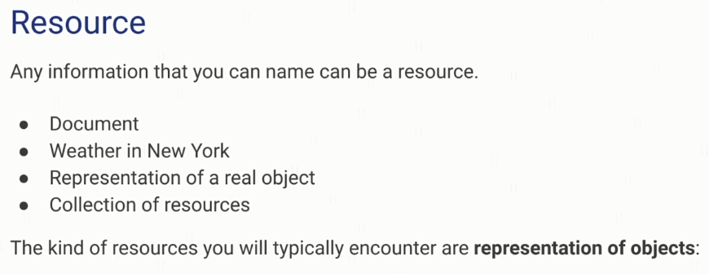
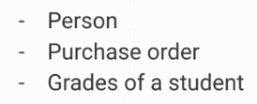
What is a Resource?

Slide 2
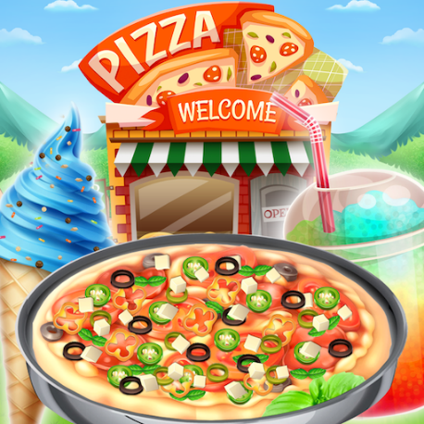
What is a Resource?
Menu
Order
Pizza
(size,crust)
Customer
Topping
Address
Sause
Payment

Slide 3
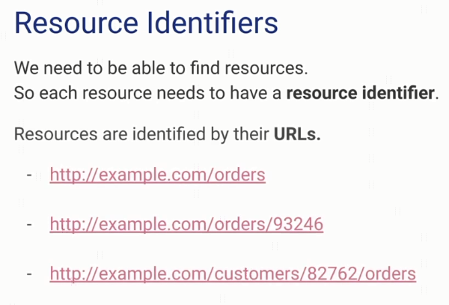
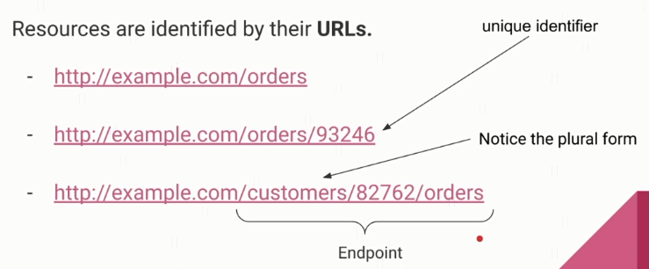
What is a Resource?

Slide 4
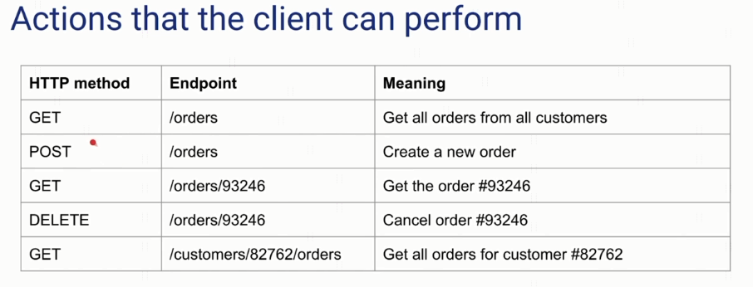
What is a Resource?

